Slide 1
Business Brochure
Name
School:
Class:
Professor:
Date:

Slide 2
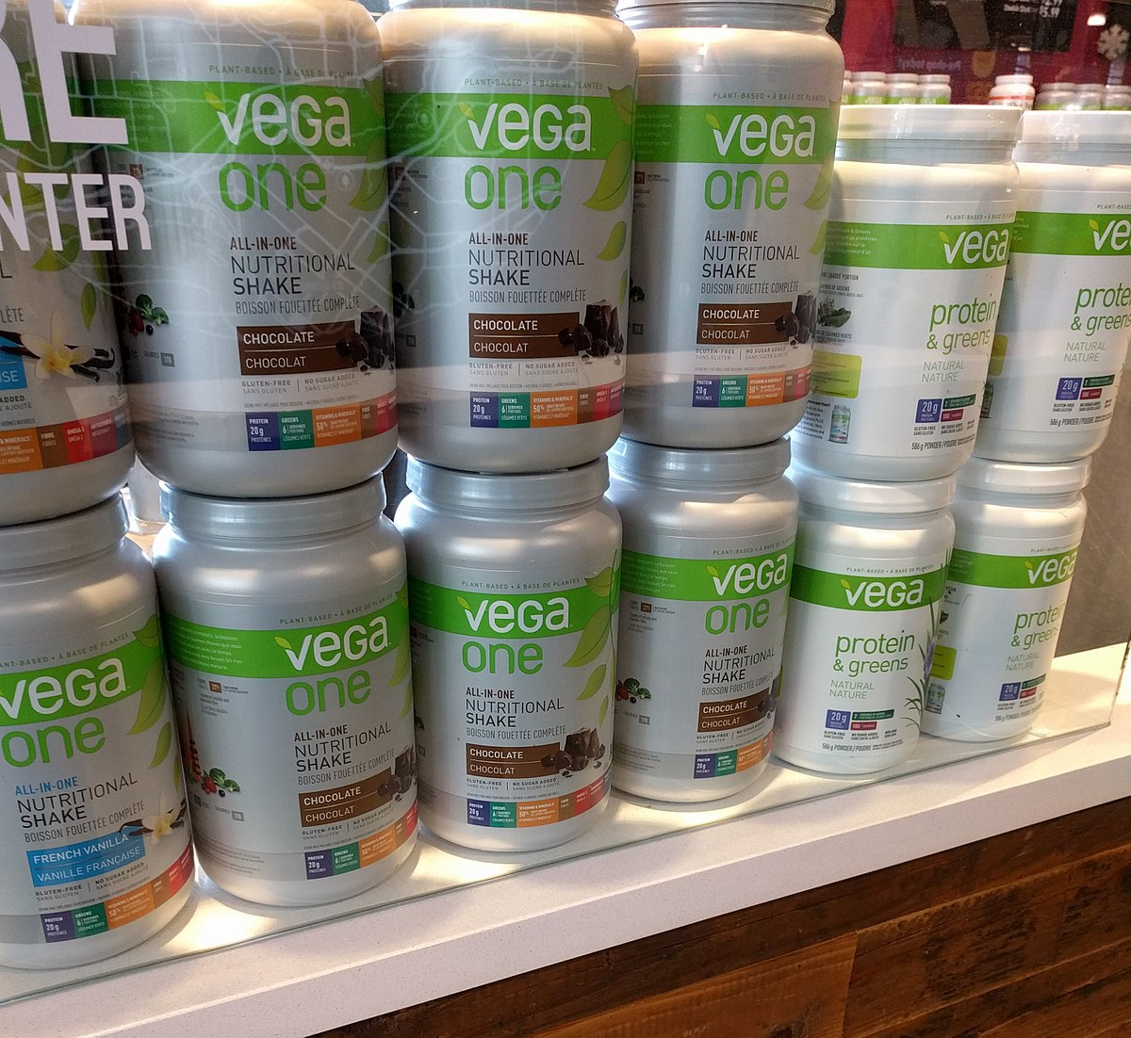



GreenLeaf Global
Contact us
+1345 899 009
Fb/Instagram pages
We are located at:
Orion global round about, City Square.
40% off!!
Greenleaf global is dedicated in providing supplement products our customers globally.
Greenleaf Global has served over 100,000 of its customers globally who are satisfied with the quality o f our products.
Why choose our product
Vegan certified
Gluten free
Low Glycemic
Made from natural herbs
Vega one product has proved to be efficient in controlling diabetes among other uses. Out of 5 consumers, 4 are satisfied with our product which makes it the best selling nutritional product.
Make your order today!!
Benefits to the consumer
Healthy life
Helps in reducing diabetes
Helps in weight loss
Keeps the body healthy

Slide 3
References
In Rosiek-Kryszewska, A., In Leksowski, K., & IGI Global,. (2018). Healthcare administration for patient safety and engagement.
Shelton, P. J. (2020). Measuring and improving patient satisfaction. Gaithersburg, Md: Aspen Publishers.

